Slide 1
Requirement Modeling
Session 09 & 10
Course : COMP6100/Software Engineering
Effective Period : Desember 2017

Slide 2
These slides have been adapted from
Pressman, R.S. (2015). Software Engineering : A Practioner's Approach. 8th ed. McGraw-Hill Companies.Inc, Americas, New York. ISBN : 978 1 259 253157. Chapter 9, 10, 11 and 12
Acknowledgement

Slide 3
LO 2 : Explain the software engineering practices and business environment
Learning Objectives

Slide 4
Contents
Requirement Analysis
Scenario-Based Modeling
Class-Based Modeling
Creating Behavioral Modeling
Requirements Modeling for Web and Mobile Apps

Slide 5
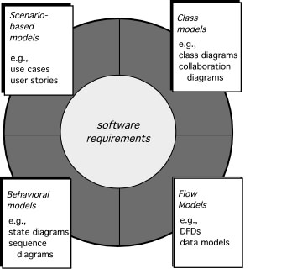
Requirement Analysis

Slide 6
Scenario-Based Modeling
“[Use-cases] are simply an aid to defining what exists outside the system (actors) and what should be performed by the system (use-cases).” Ivar Jacobson
  (1) What should we write about?
  (2) How much should we write about it?
  (3) How detailed should we make our description?
  (4) How should we organize the description?

Slide 7
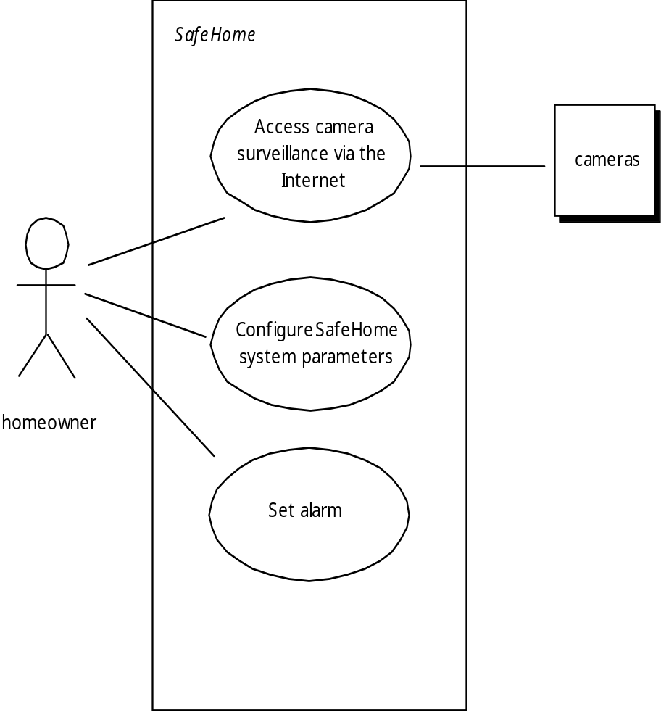
Use-Cases
Scenario-Based Modeling
a scenario that describes a “thread of usage” for a system
actors represent roles people or devices play as the system functions
users can play a number of different roles for a given scenario

Slide 8
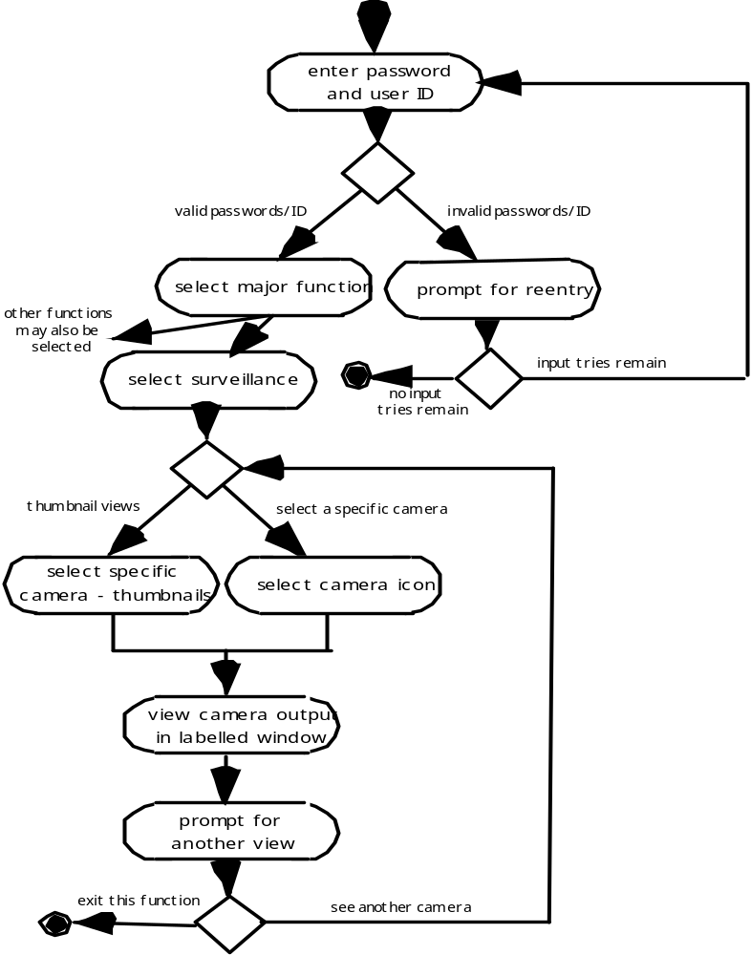
Activity Diagram
Scenario-Based Modeling
Supplements the use case by providing a graphical representation of the flow of interaction within a specific scenario

Slide 9
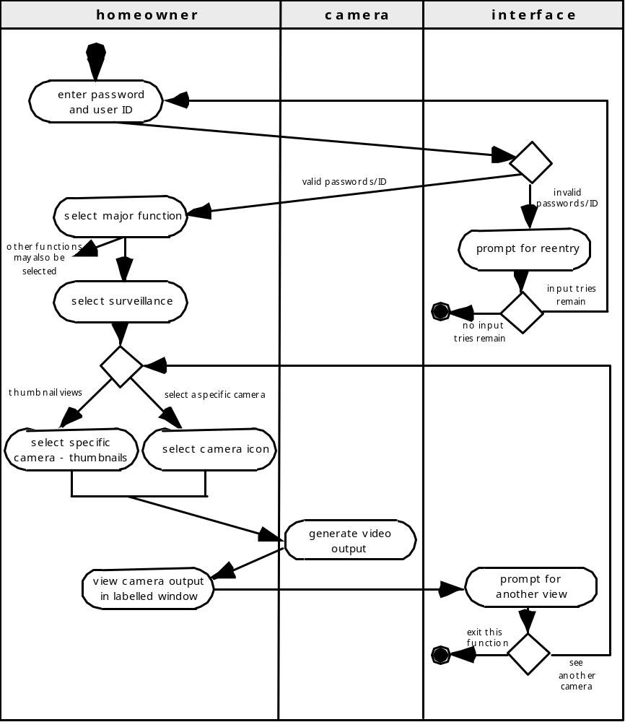
Swimlane Diagrams
Scenario-Based Modeling
Allows the modeler to represent the flow of activities described by the use-case and at the same time indicate which actor (if there are multiple actors involved in a specific use-case) or analysis class has responsibility for the action described by an activity rectangle

Slide 10
Class-Based Modeling
Class-based modeling represents:
  objects that the system will manipulate
  operations (also called methods or services) that will be applied to the objects to effect the manipulation
  relationships (some hierarchical) between the objects
  collaborations that occur between the classes that are defined.
The elements of a class-based model include classes and objects, attributes, operations, CRC models, collaboration diagrams and packages.

Slide 11
Identifying Analysis Classes
Class-Based Modeling
Examining the usage scenarios developed as part of the requirements model and perform a "grammatical parse" [Abb83]
  Classes are determined by underlining each noun or noun phrase and entering it into a simple table.
  Synonyms should be noted.
  If the class (noun) is required to implement a solution, then it is part of the solution space; otherwise, if a class is necessary only to describe a solution, it is part of the problem space.
But what should we look for once all of the nouns have been isolated?

Slide 12
Class-Based Modeling
Manifestations of Analysis Classes
Analysis classes manifest themselves in one of the following ways:
External entities: (e.g., other systems, devices, people) that produce or consume information
Things: (e.g, reports, displays, letters, signals) that are part of the information domain for the problem
Occurrences or events: (e.g., a property transfer or the completion of a series of robot movements) that occur within the context of system operation
Roles: (e.g., manager, engineer, salesperson) played by people who interact with the system
Organizational units: (e.g., division, group, team) that are relevant to an application
Places: (e.g., manufacturing floor or loading dock) that establish the context of the problem and the overall function
Structures: (e.g., sensors, four-wheeled vehicles, or computers) that define a class of objects or related classes of objects

Slide 13
Class-Based Modeling
Defining Attributes
Attributes describe a class that has been selected for inclusion in the analysis model.
  build two different classes for professional baseball players
    For Playing Statistics software: name, position, batting average, fielding percentage, years played, and games played might be relevant
    For Pension Fund software: average salary, credit toward full vesting, pension plan options chosen, mailing address, and the like.

Slide 14
Defining Operations
Class-Based Modeling
Do a grammatical parse of a processing narrative and look at the verbs
Operations can be divided into four broad categories:
  (1) operations that manipulate data in some way (e.g., adding, deleting, reformatting, selecting)
  (2) operations that perform a computation
  (3) operations that inquire about the state of an object, and
  (4) operations that monitor an object for the occurrence of a controlling event.

Slide 15
Class-Based Modeling
CRC Models
Class-responsibility-collaborator (CRC) modeling [Wir90] provides a simple means for identifying and organizing the classes that are relevant to system or product requirements. Ambler [Amb95] describes CRC modeling in the following way:
  A CRC model is really a collection of standard index cards that represent classes. The cards are divided into three sections. Along the top of the card you write the name of the class. In the body of the card you list the class responsibilities on the left and the collaborators on the right.

Slide 16
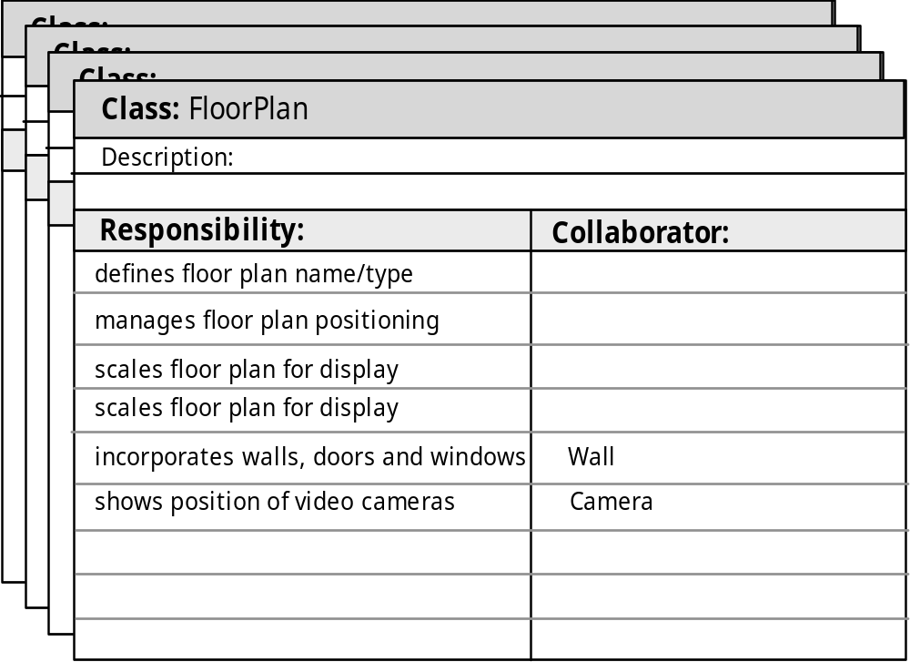
CRC Modeling
Class-Based Modeling

Slide 17

Composite Aggregate Class
Class-Based Modeling

Slide 18
Associations and Dependencies
Class-Based Modeling
Two analysis classes are often related to one another in some fashion
  In UML these relationships are called associations
  Associations can be refined by indicating multiplicity (the term cardinality is used in data modeling
In many instances, a client-server relationship exists between two analysis classes.
  In such cases, a client-class depends on the server-class in some way and a dependency relationship is established

Slide 19
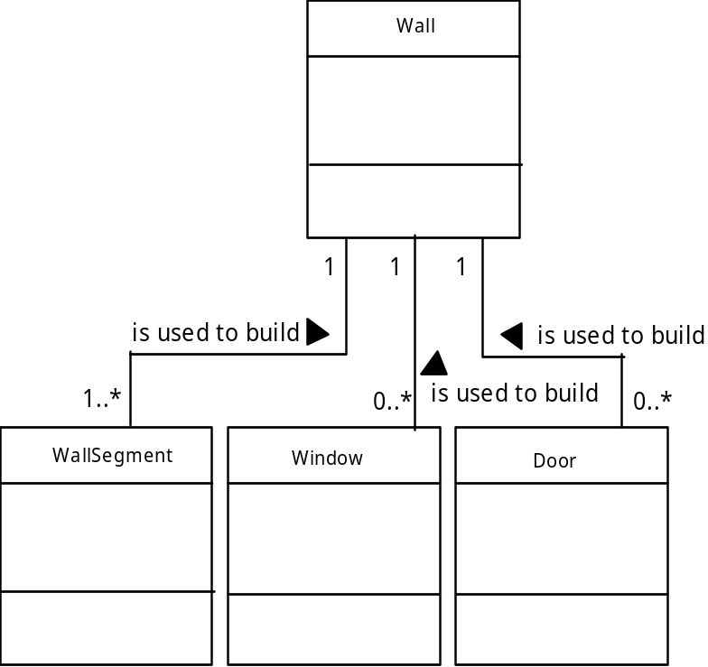
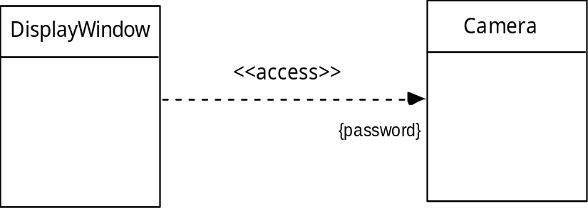
Multiplicity
Class-Based Modeling
Dependencies

Slide 20
Analysis Packages
Class-Based Modeling
Various elements of the analysis model (e.g., use-cases, analysis classes) are categorized in a manner that packages them as a grouping
The plus sign preceding the analysis class name in each package indicates that the classes have public visibility and are therefore accessible from other packages.
Other symbols can precede an element within a package. A minus sign indicates that an element is hidden from all other packages and a # symbol indicates that an element is accessible only to packages contained within a given package.

Slide 21
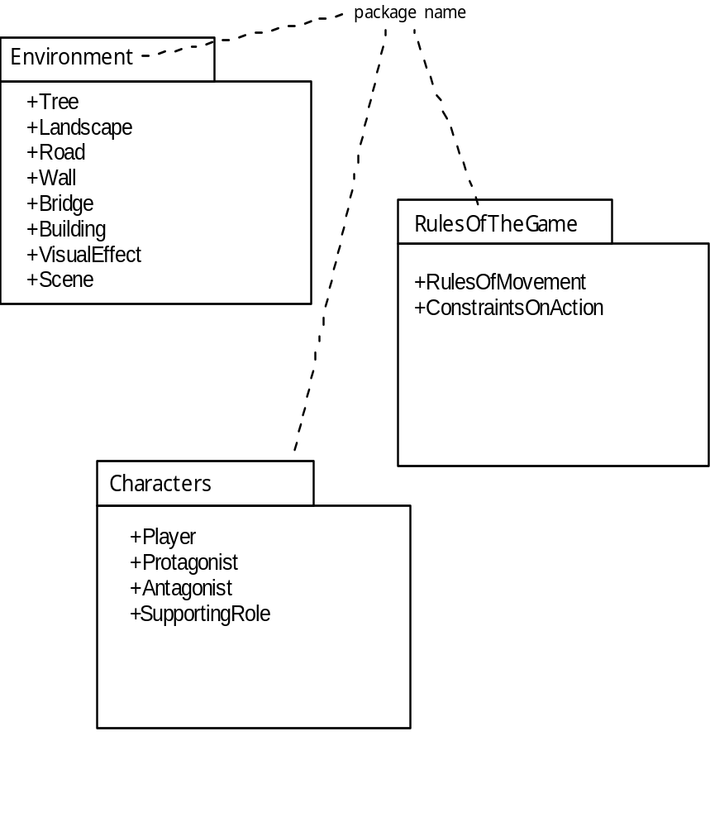
Analysis Packages
Class-Based Modeling

Slide 22
Creating A Behavioral
Modeling
The behavioral model indicates how software will respond to external events or stimuli. To create the model, the analyst must perform the following steps:
    Evaluate all use-cases to fully understand the sequence of interaction within the system.
    Identify events that drive the interaction sequence and understand how these events relate to specific objects.
    Create a sequence for each use-case.
    Build a state diagram for the system.
    Review the behavioral model to verify accuracy and consistency.

Slide 23
State Representations
Creating A Behavioral
Modeling
In the context of behavioral modeling, two different characterizations of states must be considered:
  the state of each class as the system performs its function and
  the state of the system as observed from the outside as the system performs its function
The state of a class takes on both passive and active characteristics [CHA93].
  A passive state is simply the current status of all of an object’s attributes.
  The active state of an object indicates the current status of the object as it undergoes a continuing transformation or processing.

Slide 24
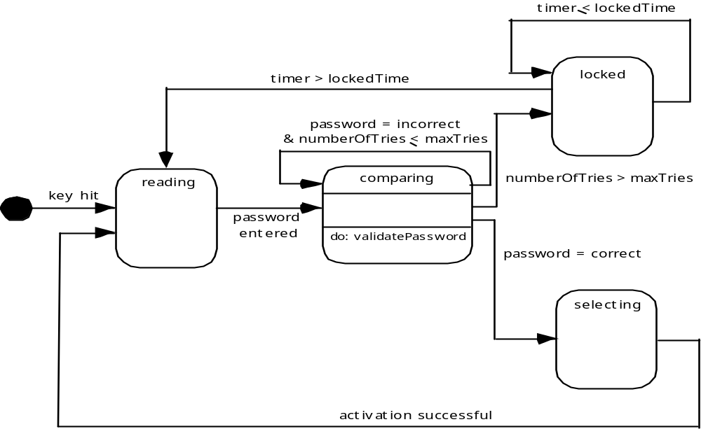
State Diagram for the ControlPanel Class
Creating A Behavioral
Modeling

Slide 25
The States of a System
Creating A Behavioral
Modeling
state—a set of observable circum-stances that characterizes the behavior of a system at a given time
state transition—the movement from one state to another
event—an occurrence that causes the system to exhibit some predictable form of behavior
action—process that occurs as a consequence of making a transition

Slide 26
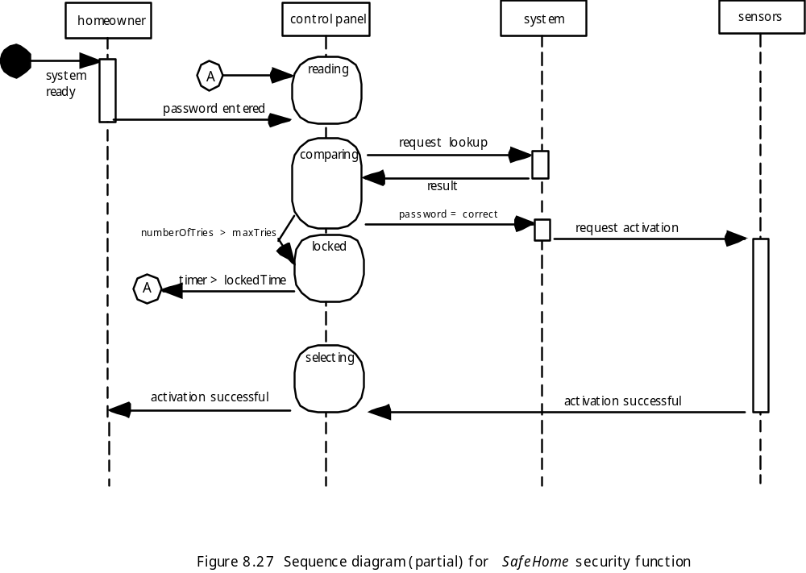
Sequence Diagram
Creating A Behavioral
Modeling

Slide 27
Requirements Modeling for Web and Mobile Apps
When Do We Perform Analysis?
In some WebE situations, analysis and design merge. However, an explicit analysis activity occurs when …
  the WebApp to be built is large and/or complex
  the number of stakeholders is large
  the number of Web engineers and other contributors is large
  the goals and objectives (determined during formulation) for the WebApp will effect the business’ bottom line
  the success of the WebApp will have a strong bearing on the success of the business

Slide 28
Requirements Modeling for Web and Mobile Apps
The Content Model
Content objects are extracted from use-cases
  examine the scenario description for direct and indirect references to content
Attributes of each content object are identified
The relationships among content objects and/or the hierarchy of content maintained by a WebApp
  Relationships—entity-relationship diagram or UML
  Hierarchy—data tree or UML

Slide 29
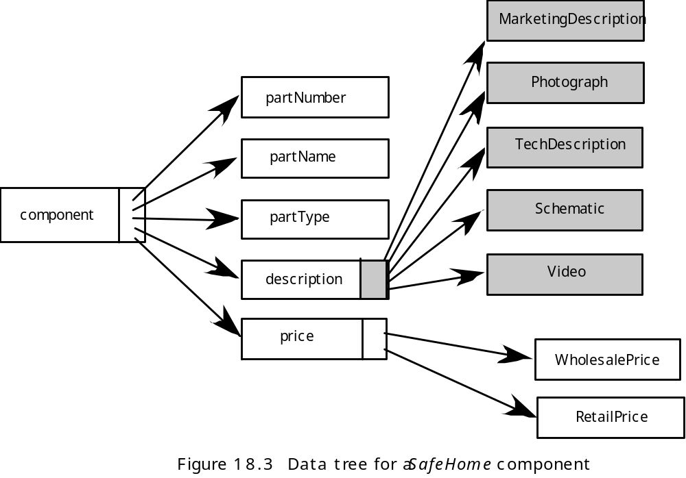
Requirements Modeling for Web and Mobile Apps
Data Tree

Slide 30
Requirements Modeling for Web and Mobile Apps
The Interaction Model
Composed of four elements:
  use-cases
  sequence diagrams
  state diagrams
  a user interface prototype

Slide 31
Requirements Modeling for Web and Mobile Apps
The Functional Model
The functional model addresses two processing elements of the WebApp
  user observable functionality that is delivered by the WebApp to end-users
  the operations contained within analysis classes that implement behaviors associated with the class.
An activity diagram can be used to represent processing flow

Slide 32
Requirements Modeling for Web and Mobile Apps
The Configuration Model
Server-side
  Server hardware and operating system environment must be specified
  Interoperability considerations on the server-side must be considered
  Appropriate interfaces, communication protocols and related collaborative information must be specified
Client-side
  Browser configuration issues must be identified
  Testing requirements should be defined

Slide 33
Exercises
You have been asked to build one of the following systems:
a network-based course registration system for your university
a web-based order-processing system for a computer store
a simple invoicing system for a small business.
an internet based cookbook that is built into an electric range or microwave,
Select the system that is of interest to you and develop an entity-relationship diagram that describes data objects, relationships, and attributes

Slide 34
Exercises
The depaftment of public works for a large city has decided to develop a web-based pothole tracking and repair system (PHTRS). A. description follows:
Citizens can log onto a website and report the location and severity of potholes. As potholes are reported they are logged within a "public works department repair system" and are assigned an identifying .number, stored by street address, size (on a scale of 1 to 1 0), location-(middle, curb, etc.), district (determined from street address), and repair priority (determined from the size of the pothole). work order data are associated with each pothole. and include pothole location and size, repair crew identifying number, number of people on crew, equipment assigned, hours applied to repair, hole status (work in progress, repaired, temporary repair, not repaired), amount of filler material used and
cost of repair computed (from hours applied, number of people, material and equipment
used). Flnally, a damage file is created to hold information about reported damage due
to the pothoie and incllude citizen's name, address, phone number, type of damage, and
dollar amount of damage. PHTRS is an online system; all queries are to be made interactively
a. Draw a UML use case diagram for the PHTRS system. You',ll have to make a number of assumptions about the manner in which a user interacts with this system.
b. Develop a class model for the PHTRS system

Slide 35
Exercises
What is the fundamental difference between the structured analysis and object-oriented strategies for requirements analysis?
There are two different types of "states" that behavioral models can represent. What are they?
Suggest three requirements pattems for a modern mobile phone and write a brief description of each. Could these patterns be used for other devices. Provide an example.

Slide 36
References
Pressman, R.S. (2015). Software Engineering : A Practioner's Approach. 8th ed. McGraw-Hill Companies.Inc, Americas, New York. ISBN : 978 1 259 253157
UML 2.0 Tutorial, http://www.youtube.com/watch?v=OkC7HKtiZC0
Introduction to Model-View-View-Model (MVVM) Pattern, http://www.youtube.com/watch?v=pY60lLotZCg

Slide 37
Q & A

